Slide 1



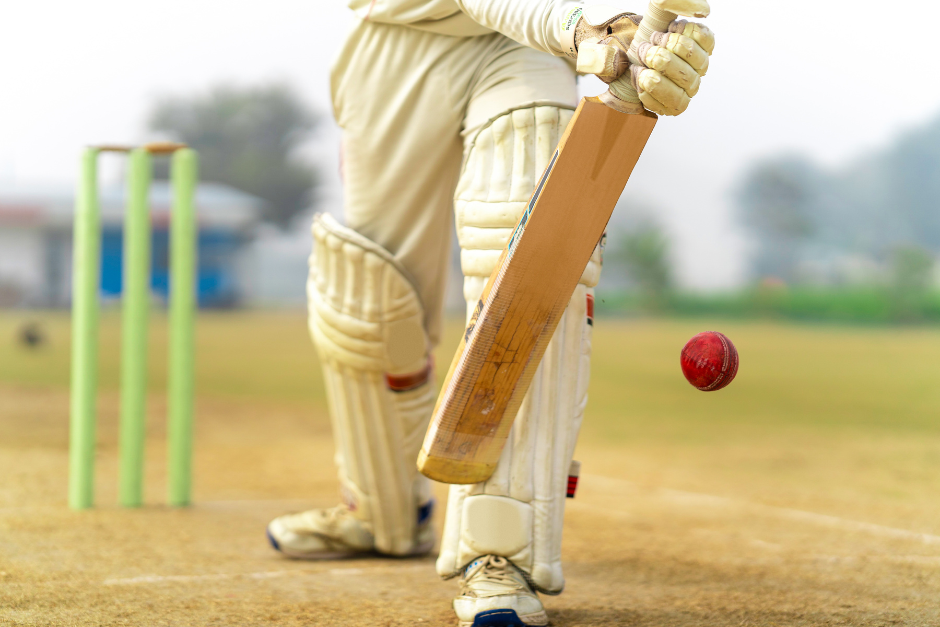
IPL WIN PROBABILITY PREDICTOR
NAME :- Vishvajitsinh Vaghela
Roll.No: - 161
Batch :- C5
Enrollment.No :- 22002170210133
Subject :- FCSP-2
Title :- IPL Win Probability Predictor

Slide 2
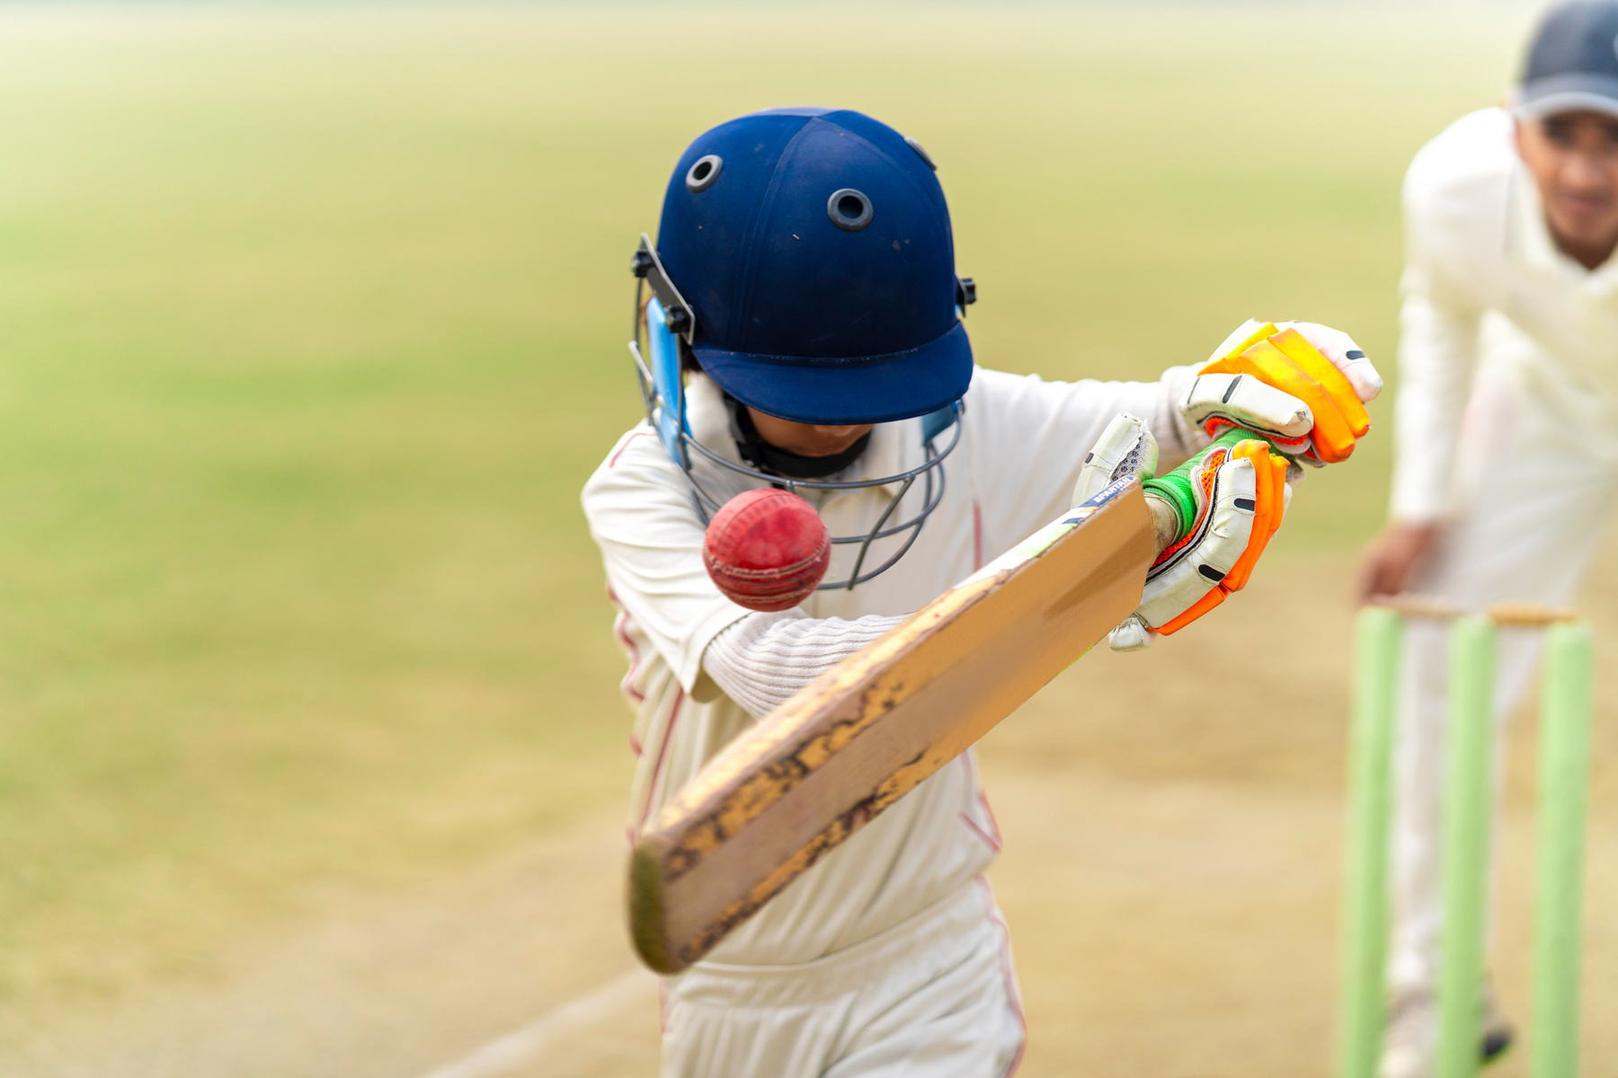

INTRODUCTION
WELCOME TO
IPL WIN PROBABILITY PREDICTOR
This project focuses on predicting win probabilities in IPL matches using machine learning. I use data like team names, city, current score, overs left, wickets left, and target to create important features such as runs left and run rates. A logistic regression model is trained to calculate the chances of each team winning. This helps fans and analysts understand how likely a team is to win during a live match, based on real-time game data.

Slide 3

DATA, MODEL AND USER INTERACTION
Data Overview
Datasets: matches.csv and deliveries.csv.
Merged data for full match context.
Key features: Teams, City, Total runs, Wickets, Overs.
Cleaned team names and focused on active IPL teams.
Model Development
Used Logistic Regression for binary win/loss prediction.
Key features: Runs left, Balls left, Wickets left, CRR, RRR.
Encoded teams and cities using OneHotEncoding.
User Interaction
Inputs: Batting team, Bowling team, City, Wickets, Overs, Score, Target.
Validates input (e.g., teams not the same, overs/wickets limits).
Outputs win probabilities for both teams.

Slide 4
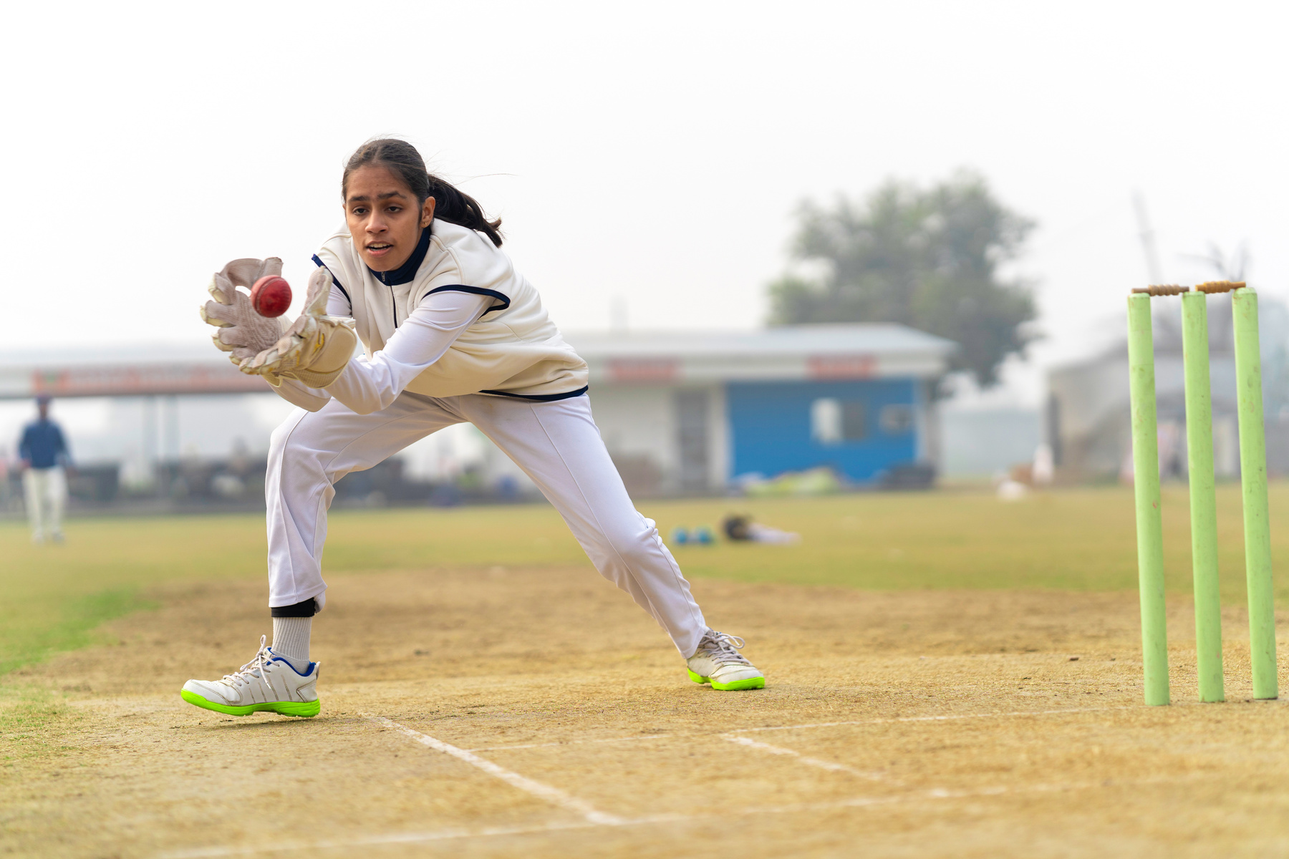
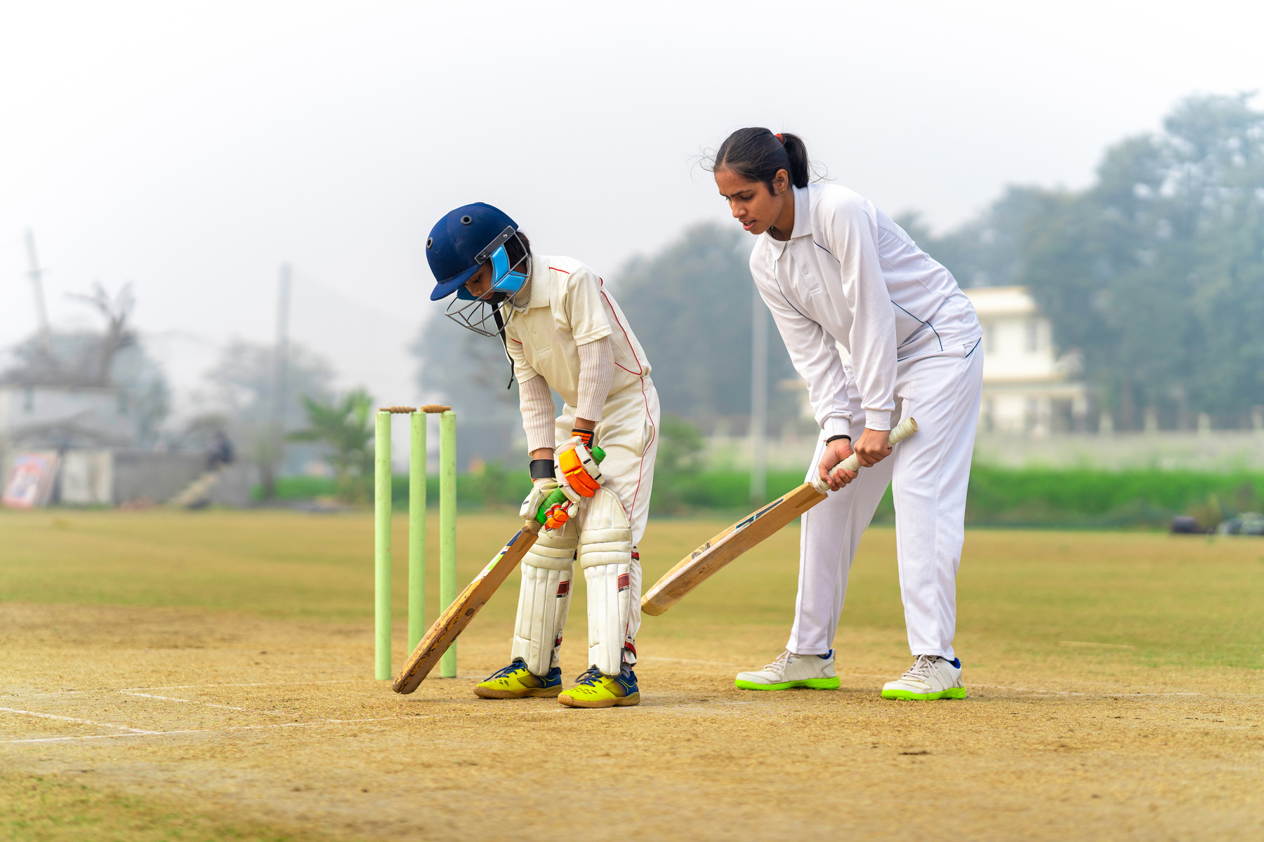
FUTURE SCOPE
Web Integration: The model can be connected to a webpage using frameworks like Django or Flask.
Expand to International Matches: The model can be adapted to predict outcomes for international T20 and ODI matches.
Additional Match Features: Add more features such as pitch conditions and player statistics for improved accuracy.
Mobile Application: The model can be integrated into a mobile app for real-time predictions during live matches.

Slide 5
THANK
YOU

